Slide 1
HW3

Slide 2
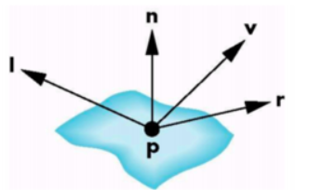
How to determine light intensity
We can simply use the included angle of the reflection and view vectors.
L is a vector towards the light source
V is a vector towards the camera position
R is a vector which is the reflection of L
N is a vector which is the normal of the point P

Slide 3
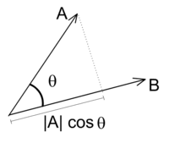
How to determine light intensity
If two vectors are unit vectors. Then we can get cosθ by doing dot products of the two vectors.
A．B = |A||B| cos θ
The smaller θ is, the larger cos θ is. According to the Phong reflection model, we can determine the light intensity based on cos θ.
If cos θ < 0, θ must bigger than 90°. In this case, this position cannot be illuminated.

Slide 4
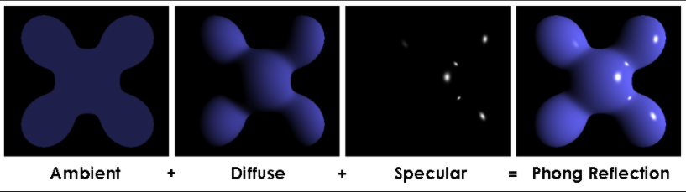
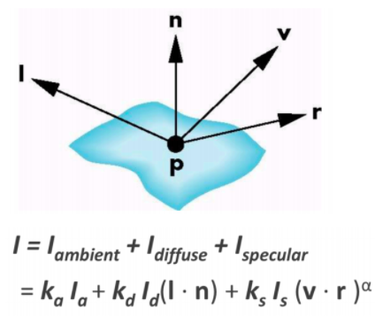
Phong shading
K is the reflectivity of each component of the material
Parameters of model material:
Ambient reflectivity (Ka) : 1.0 1.0 1.0
Diffuse reflectivity (Kd) : 1.0 1.0 1.0
Specular reflectivity (Ks) : 0.7 0.7 0.7
Gloss (α) : 10.5
L is the intensity of each component of the light.
Parameters of light:
Ambient intensity (La) : 0.2 0.2 0.2
Diffuse intensity (Ld) : 0.8 0.8 0.8
Specular intensity (Ls) : 0.5 0.5 0.5
Position : (10, 10, 10)

Slide 5
Phong shading - pseudocode
void main()
{
object_color = texture2D(Texture, texcoord);
ambient = La * Ka * object_color;
diffuse = Ld * Kd * object_color * dot(L,N); // must > 0
specular = Ls * Ks * pow(dot(V,R), gloss);
color = ambient + diffuse + specular;
}

Slide 6
Gouraud shading - pseudocode
void main()
{
// in vertex shader
Calculate ambient, diffuse, specular on vertex.
// in fragment shader
Render the fragment with the interpolated light intensities.
}

Slide 7
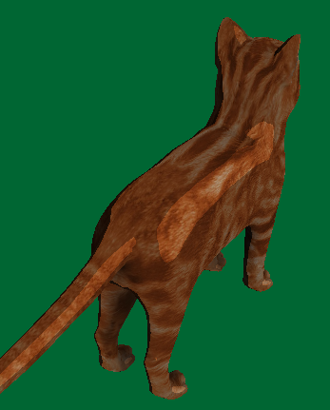
Toon shading - pseudocode
void main()
{
object_color = texture2D(Texture, texcoord);
Calculate the angle between the light and normal vector
If not lighted (angle > 90), low intensity
If strong specular, high intensity
Else, medium intensity
// you can decide the intensity and specular threshold
Color = Kd * object_color * intensity ;
}
Low intensity
Medium intensity
High intensity
Green background color for display purpose, you can choose your own background color

Slide 8
Edge effect
normal
V
center
camera
object
V
normal
Notes:
可以用normal跟view的角度來做到edge effect

Slide 9
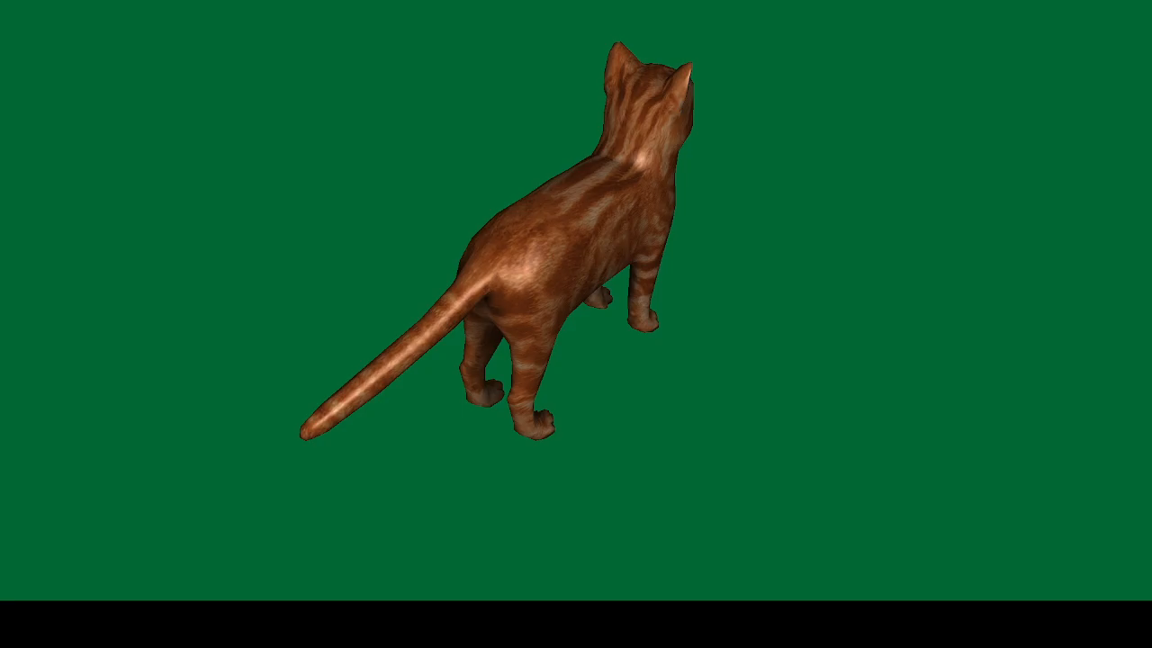
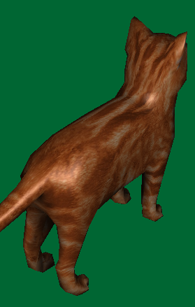
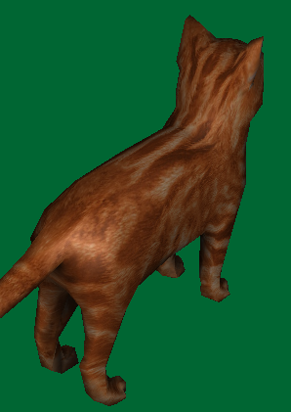
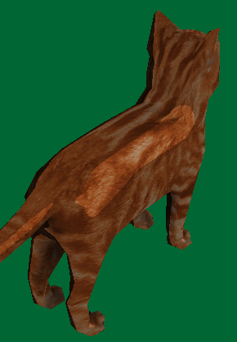
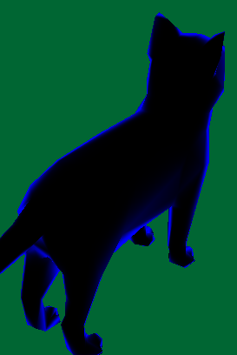
Homework 3
Goal :
Phong shading
Gouraud shading
Toon shading
Edge effects
Phong shading
Gouraud shading
Toon shading
Edge effects

Slide 10
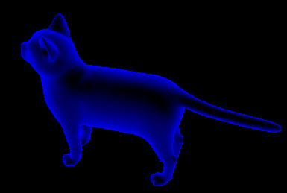
Homework 3 - score
1. create shaders and programs you need and can switch them correctly.(5%)
2. Create all variable and pass them to shaders through Uniform(5%)
3. Implement Phong shading via shader (25%)
4. Implement Gouraud shading via shader (20%)
5. Implement Toon shading via shader(15%)
# at least define 3 levels.
6. Implement Edge effects via shader(10%)
# must clearly see the edge
# The color of the edge is not specified
7. Report (20%)
This is not allowed

Slide 11
Reminder
The cat is rotating about y axis 45 degree/second. Create the model transform matrix accordingly. You can get perspective and view matrices from getPerspective() and getView().
The light position, camera position and the model position might not be in the same space. You might need to deal with that.
This will work in this homework, but it is the wrong way to do the space conversion.

Slide 12
Homework 3 (report)
Please specify your name and student ID in the report.
Explain how you implement the above shading/effects.
(ex: how I get the vector L. I do dot(L, N) for what……etc.)
Describe the problems you met and how you solved them.

Slide 13
Homework 3 - submission
Deadline: 2022/12/6 23:59:59
10% penalty for each week late
Pack your report and project in a zip file. File name: studentID_hw3.zip

Slide 14
Files to be implemented
main.cpp
shaders/Phong.vert
shaders/Phong.frag
shaders/Toon.vert
shaders/Toon.frag
shaders/Edge.vert
shaders/Edge.frag
shaders/Gouraud.vert
shaders/Gouraud.frag

